Slide 1


PRESENTATION
CYBER SECURITY
TASK 2
BY ZUHRA SHAVKATOVA

Slide 2
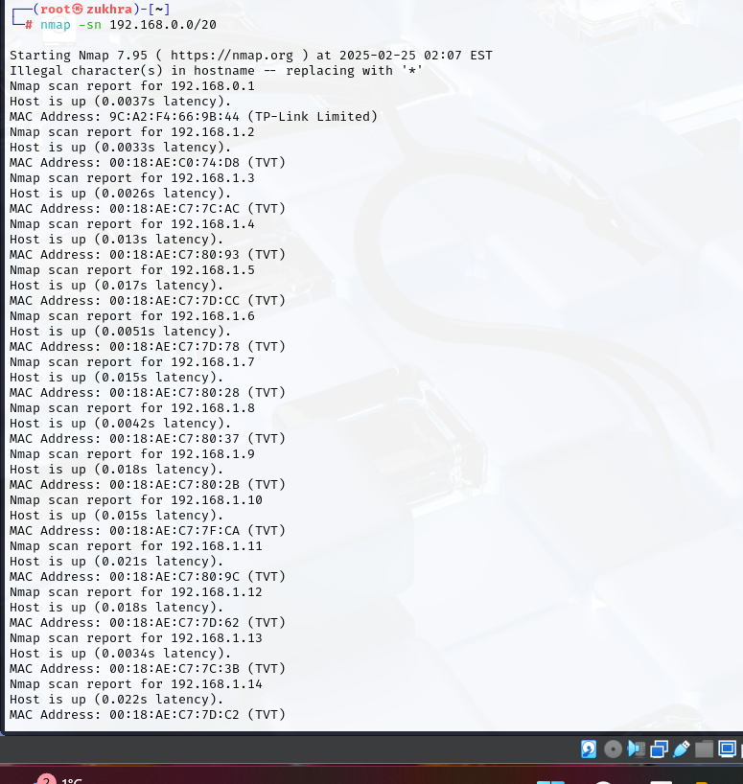
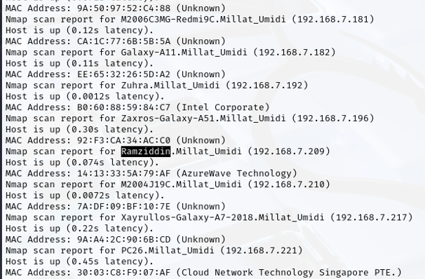
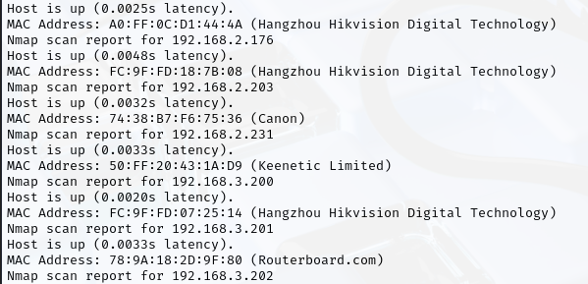
SCAN
NMAP -SN 192.168.0.0/20
nmap — a tool used to scan devices on a network.
-sn — this option only detects active devices on the network without scanning ports.

Slide 3
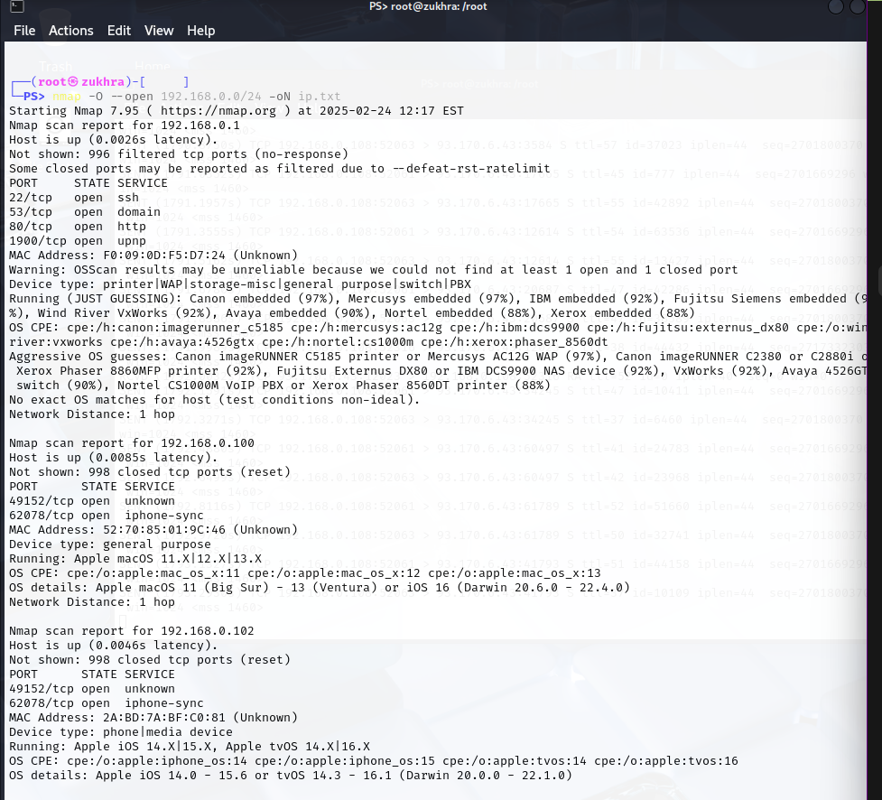
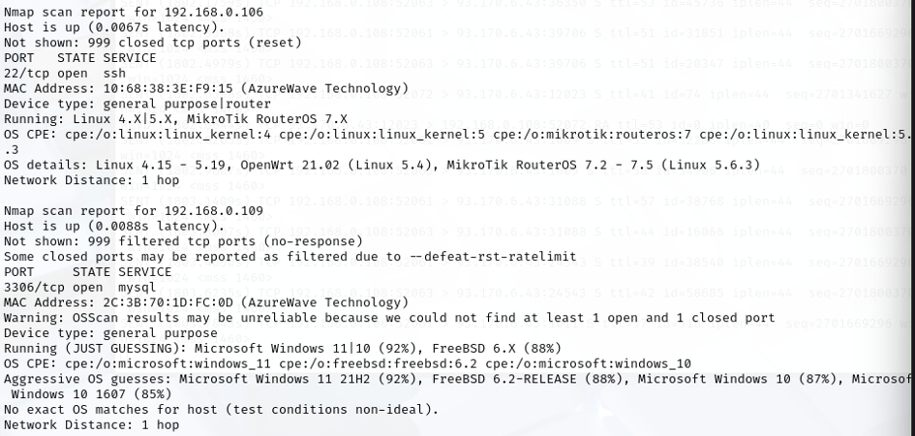
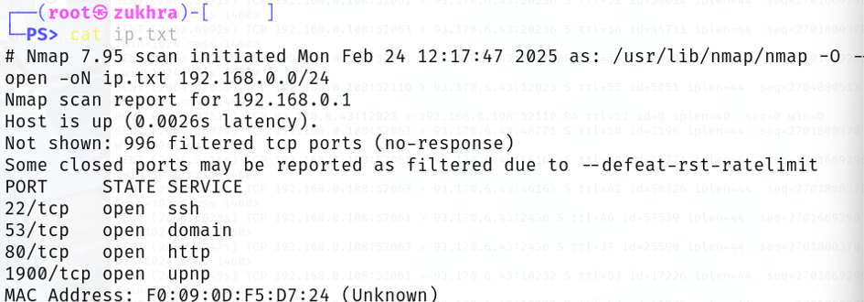
NMAP -O --OPEN 192.168.0.0/24 -ON IP.TXT
-O → Detects the Operating System (OS) of hosts.
--open → Shows only open ports.
-oN ip.txt → Saves results in ip.txt.

Slide 4
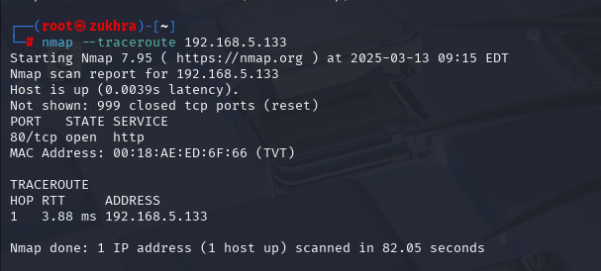
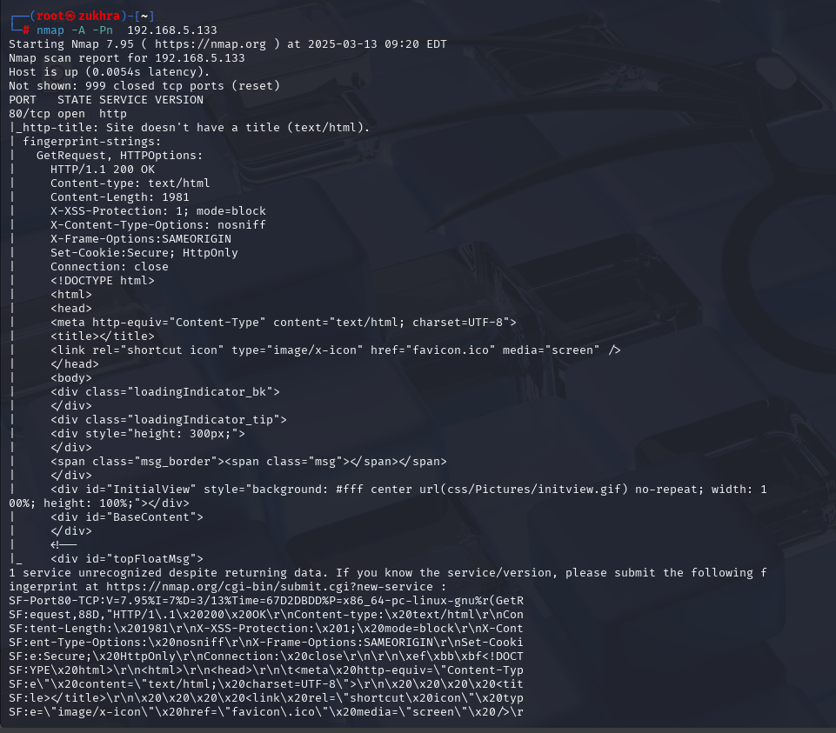
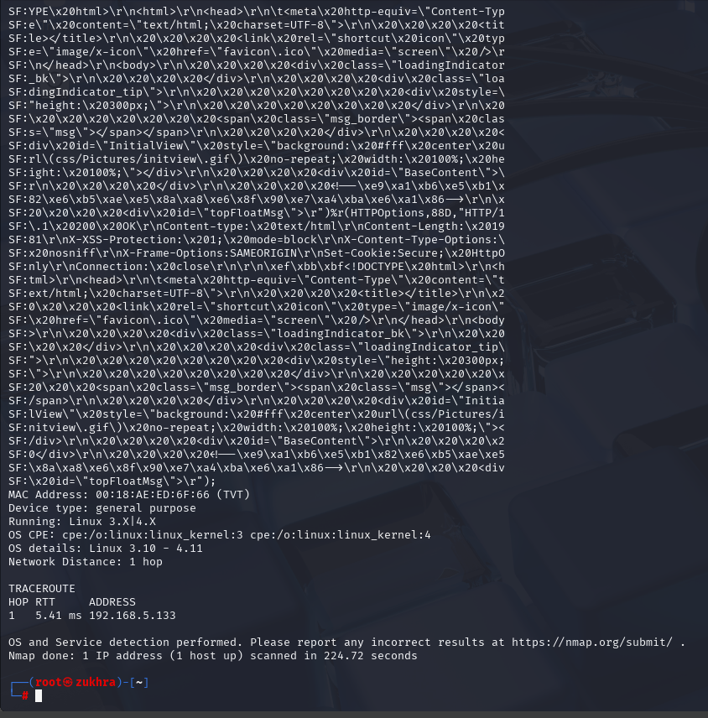
NMAP --TRACEROUTE 192.168.5.133
Performs traceroute → Shows the path (hops) packets take to reach the destination.
NMAP -A -PN 192.168.5.133
-A → Aggressive scan (Detect OS, services, traceroute). Full scan (OS, services, ports)
-Pn → Skips host discovery (Assumes all hosts are online).

Slide 5
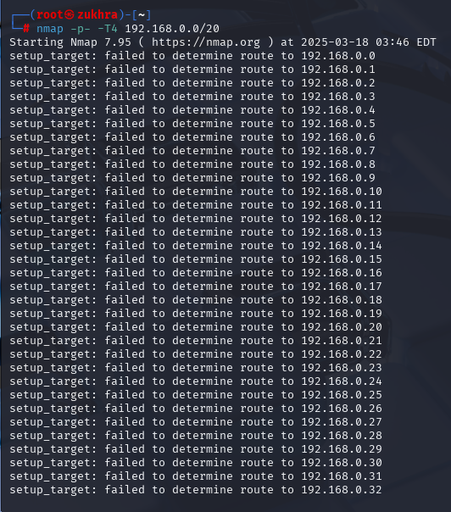
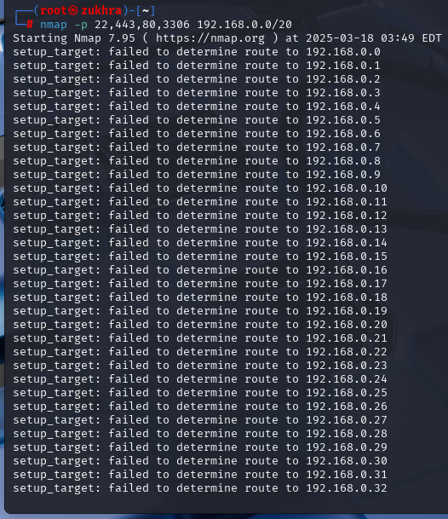
NMAP -P- 192.168.0.0/20
Scans all ports (0-65535)
NMAP -P- -T4 192.168.0.0/20
Same, but faster (-T4)
-T4 increases speed (aggressive timing).
NMAP -P 22,443,80,3306 192.168.0.0/20
22 - scaning for ssh
443 - scaning for https
80 - scaning for http
3306 - scaning mysql

Slide 6
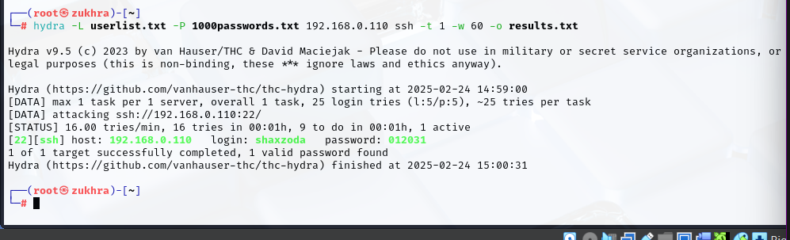
HYDRA -L USERLIST.TXT -P 1000PASSWORDS.TXT 192.168.0.1 SSH -T 4 -W -O RESULTS.TXT
1️⃣ -L userlist.txt →Uses a list of usernames
2️⃣ -P 1000passwords.txt → Uses a list of passwords
3️⃣ 192.168.0.1 ssh → Targets 192.168.0.1 on the SSH service.
4️⃣ -t 4 → Runs 4 parallel login attempts at the same time.
5️⃣ -w → Waits longer for responses (avoids lockouts).
6️⃣ -o results.txt → Saves the results to results.txt.
HYDRA IS A BRUTE-FORCE PASSWORD CRACKING TOOL.

Slide 7
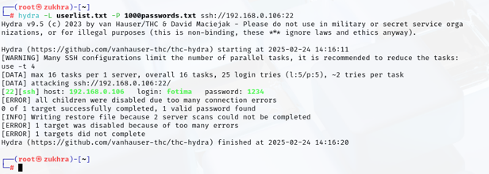
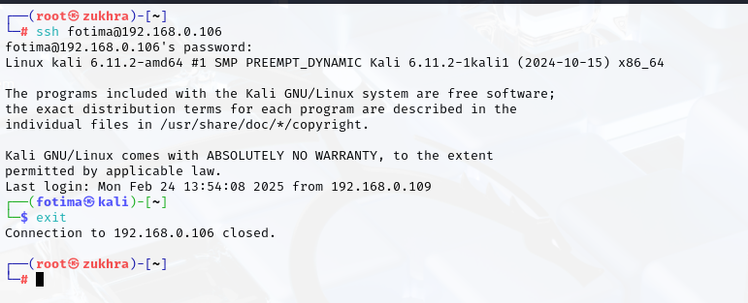
I USED THE COMMAND SSH FOTIMA@192.168.0.106
I successfully accessed fotima’s Kali Linux system (192.168.0.106) via SSH and then logged out.

Slide 8
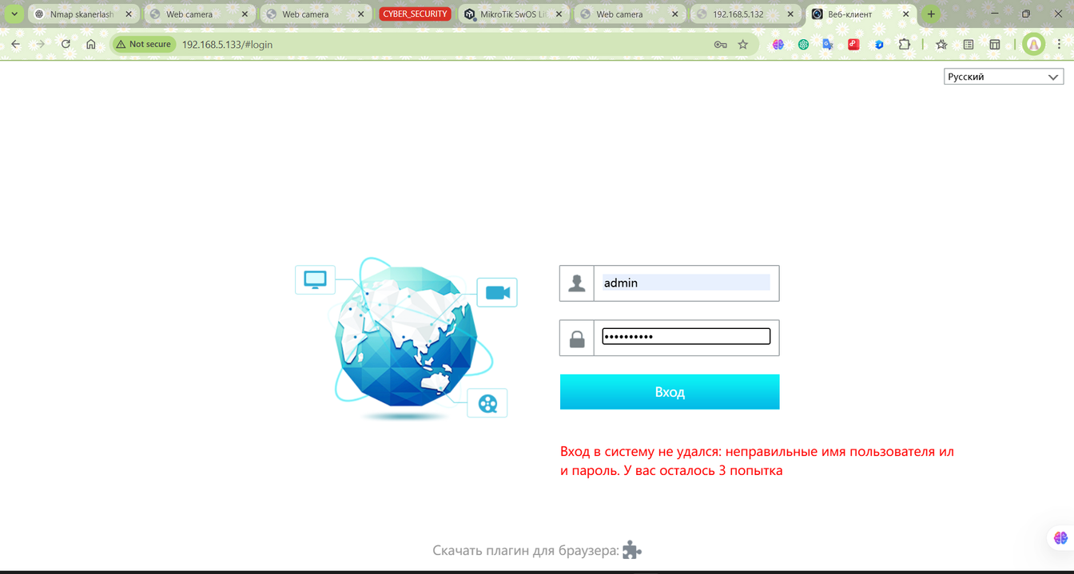
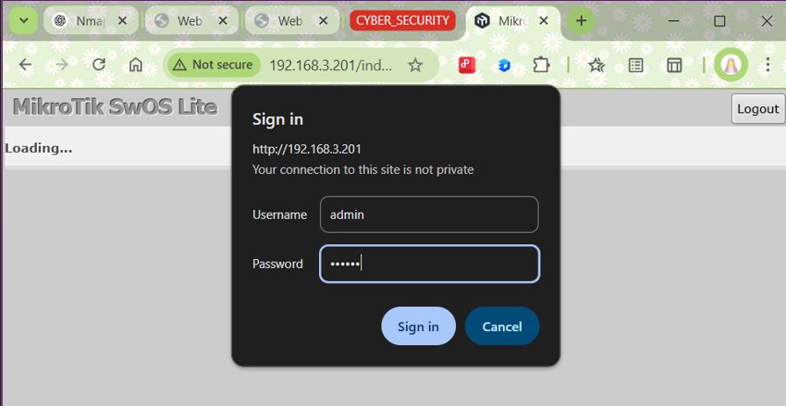
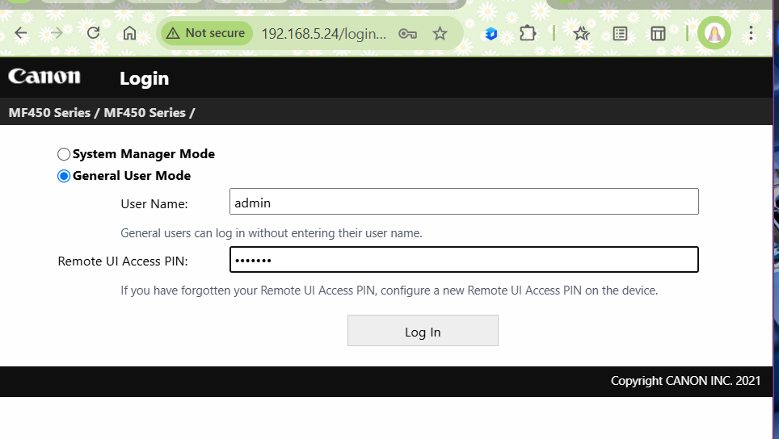
I TRIED TO ACCESS THIS MIKROTIK SWOS LITE USING THE IP ADDRESS IN A BROWSER. BECAUSE HTTP PORT 80 WAS OPEN.

Slide 9
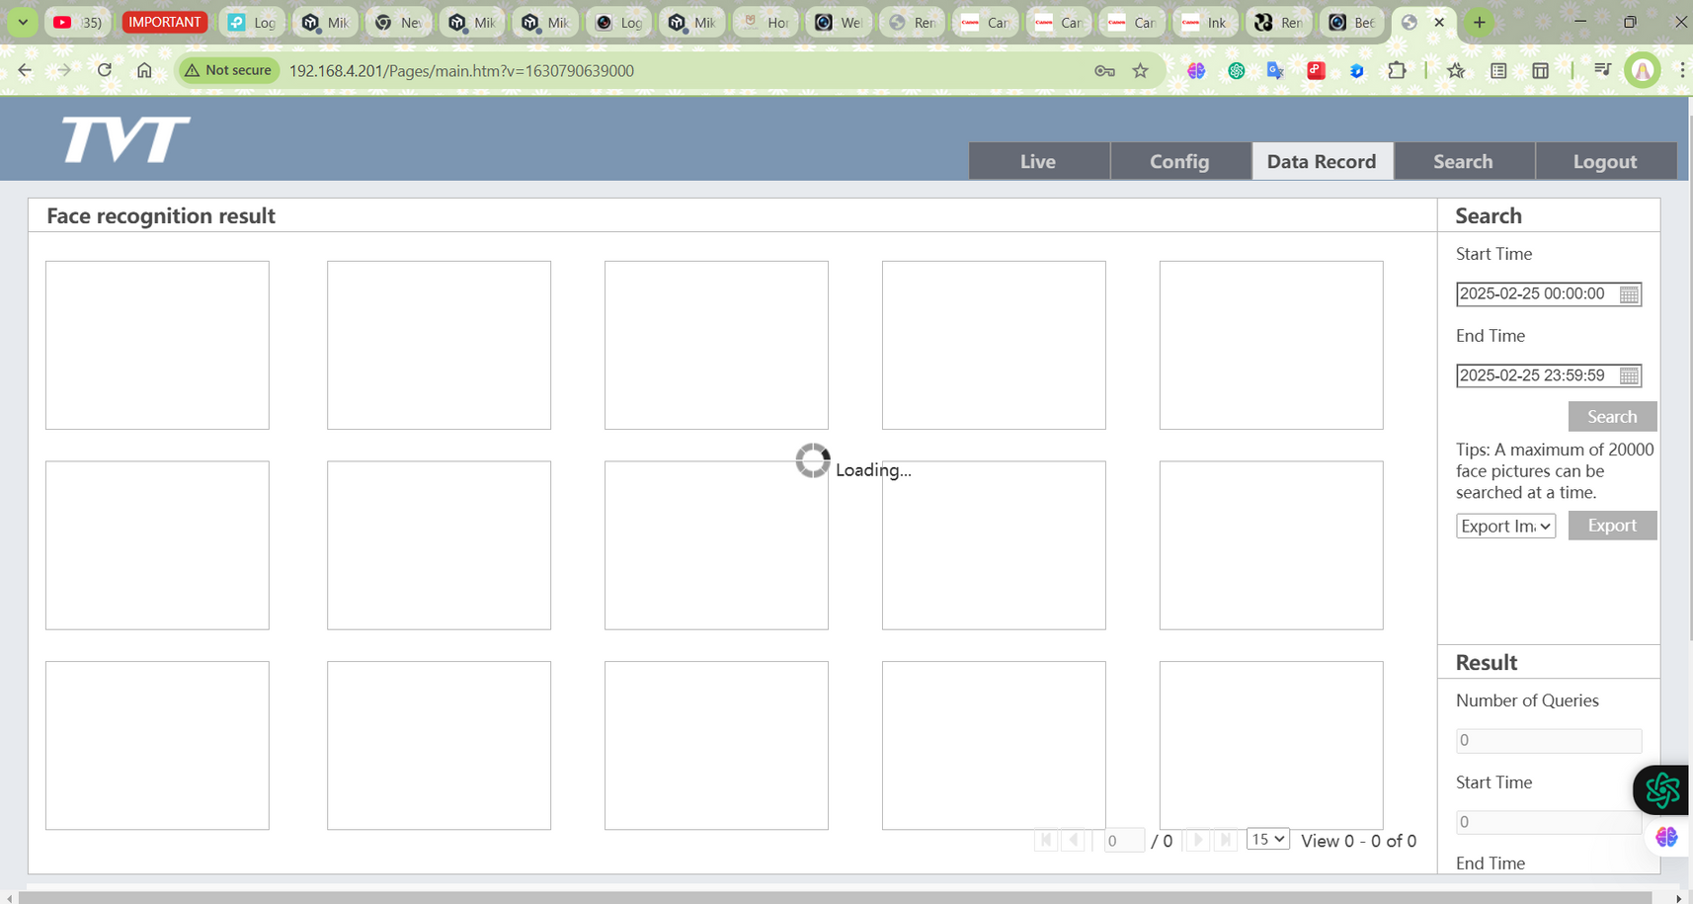
I ACCESSED THE TVT FACE RECOGNITION SYSTEM BY THE LOCAL NETWORK USING HTTP (PORT 80) AT 192.168.4.201.

Slide 10
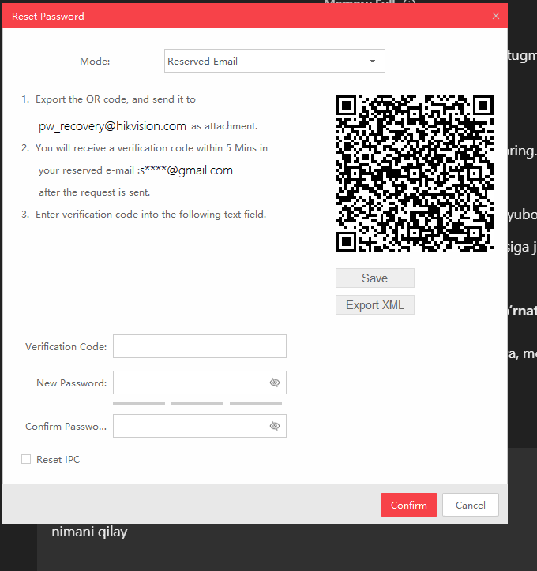
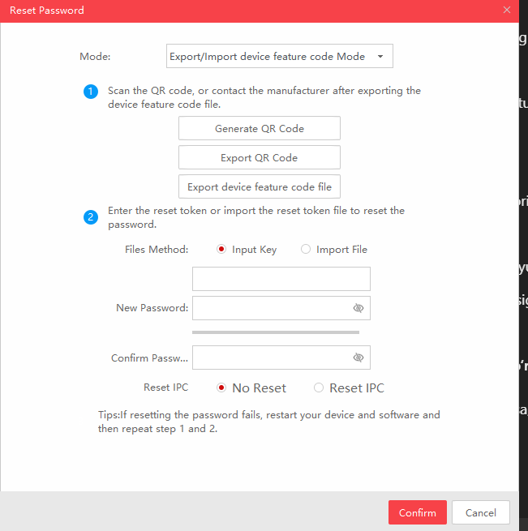
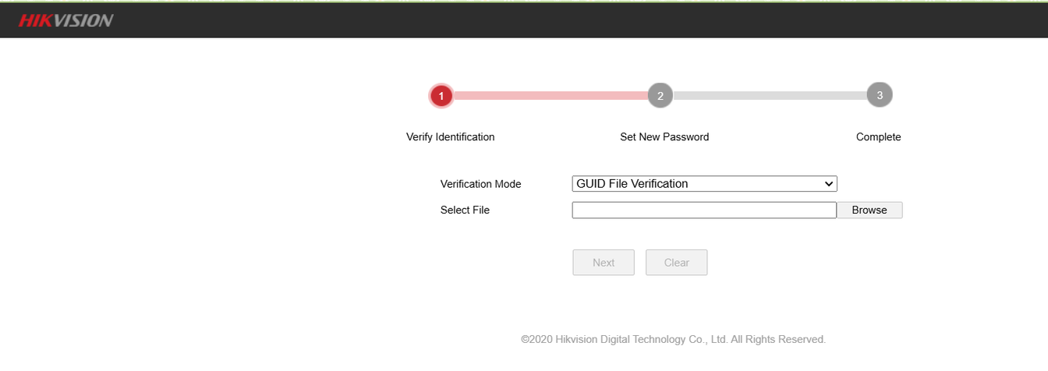
SADP (SEARCH ACTIVE DEVICE PROTOCOL)
HIKVISION SADP TOOL, USED TO FIND AND MANAGE HIKVISION NETWORK DEVICES.
I TRIED TO ACCESS MY HIKVISION DEVICE:
I ENTERED THE HIKVISION LOGIN PAGE AND TESTED COMMON PASSWORDS, BUT NONE WORKED.
I CLICKED ON "FORGOT PASSWORD" TO RESET IT.
I INSTALLED THE SADP TOOL TO RECOVER THE PASSWORD.
I OPENED SADP, SELECTED MY DEVICE, AND EXPORTED THE RESET FILE.
I UPLOADED THE FILE TO HIKVISION’S SUPPORT FOR VERIFICATION.
I RECEIVED THE GUID FILE AND UPLOADED IT TO THE RESET PAGE.
I TRIED TO SET A NEW PASSWORD, BUT I COULDN’T LOG IN
PAGE 09

Slide 11
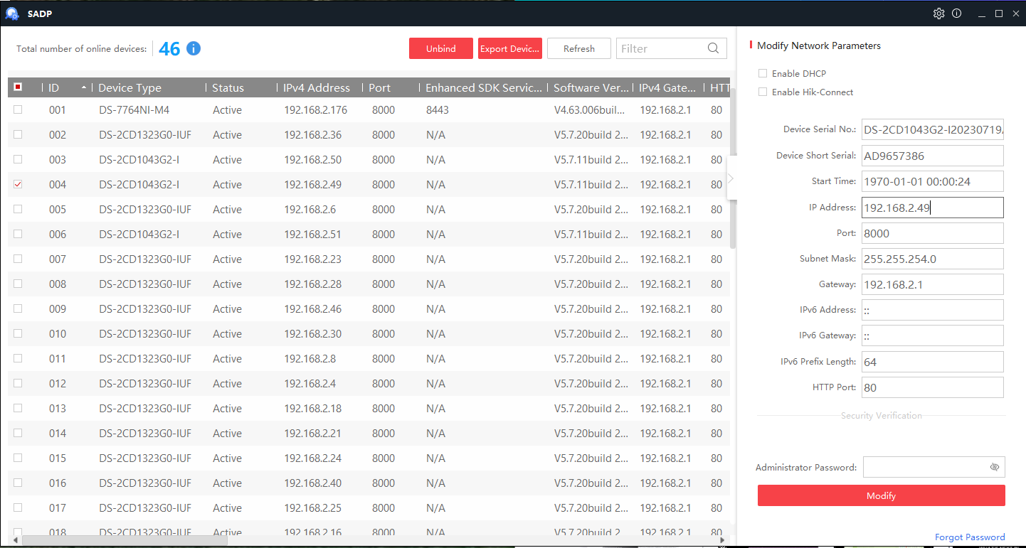

Slide 12
THANK YOU !

